Slide 1
SAI Japan's audit results on leaks
of individual information
from the Japan Pension Service
For 28th WGITA meeting in Fiji
SAI-JAPAN
Board of Audit of Japan
Ichiro Osaka
Auditor , Certified Public Accountant
Helth & Welfare Audit Division,
ASTRA
Kaori Tanaka
Auditor , IT auditor
Fisheries & Livestock Audit Division, ASTRA

Slide 2
Before starting
ICHIRO OSAKA
Not a baseball or a tennis player.
From ASTRA
Means “IT Audit Skill-up TRAining team”
Has educated 51 members in 1,246 staffs
Have attended WGITA meetings since 2006
→ Remember ASTRA please !!

Slide 3
Today’s goal
Making discussions on SAI's mandate
for Information Security Audit
in the capacity of Effectiveness audit.

Slide 4
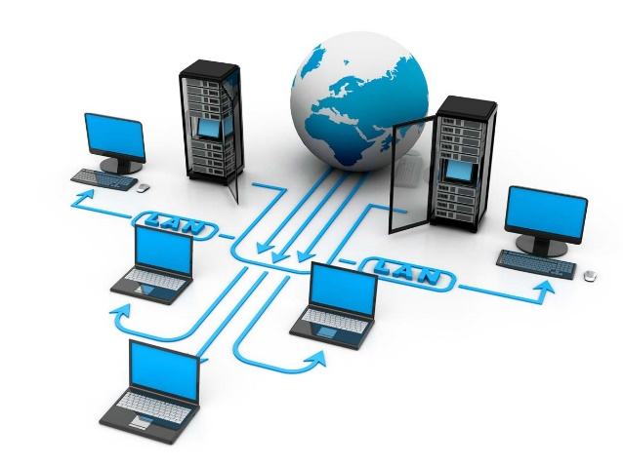
Contents
1. The scheme of Japanese Pension System
Leaks of individual information from JPS in 2015 and factual backgrounds found by investigation committees
Audit mandate of SAI Japan on information security as a part of effectiveness audit
Audit Results
Conclusion

Slide 5
1. The scheme of Japanese Pension System
Employees’ Pension
Insurance
Mutual Aid Pension
2nd Tier
National Pension(Basic Pension)
1st Tier
Dependent spouses of those who are covered by employees’ pension etc.
Self-employed individuals
Company employees
Public
employees
Insured individuals : 67million people
Benefits : 500 billion USD/year

Slide 6
Insured individuals,beneficiaries,and employers
Applications
Japan Pension Service
Responsible for operation
s
Supervision
MHLW(Minister of Health,Labour and Welfare)
Financial and administrative responsibility

Slide 7
2. Leaks of individual information from
the Japan Pension Service
In May 2015, about 1,250,000 cases of individual information related to the National Pension were leaked by persistent Targeted Attacks
Malware

Slide 8
The internet
Pension information system
Social Security On-line System
(67millions individual
information)
JPS LAN System
(File sharing server)
Customer’s Web Portal
JPS headquarters
Pension office
On-line Terminal PC
LAN Terminal PC
On-line Terminal PC
LAN Terminal PC
(Note) The thick lines indicate that the network is connected to the internet.

Slide 9
Investigation reports published prior to SAI Japan's audit
Investigation committees | Descriptions
National Cyber Security Center | - Absence of CSIRT (Computer Security Incident Response Team) - Necessary measures to prevent recurrence
JPS’internal investigation committee | - Absence of practical countermeasures against cyber attacks - Chief Information Officer failed to give concrete instructions to respond to the incident. - Poor data protection
Independent Committee commissioned by the MHLW | - Poor coordination between JPS and the MHLW - Ineffective oversight on JPS's LAN System by the MHLW

Slide 10
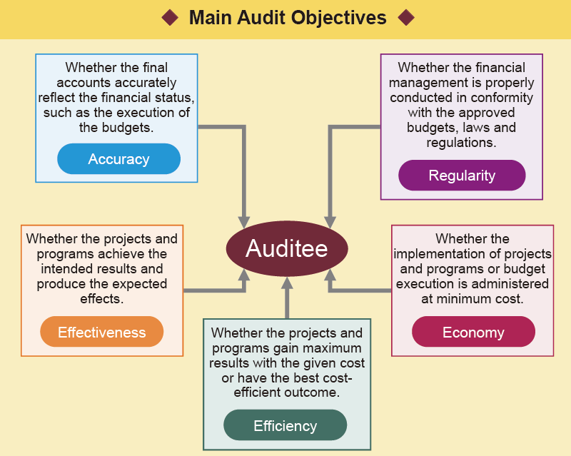
3. Audit mandate of SAI Japan

Slide 11
4. Audit Results
JPS’s readiness to revise its Information Security Policy
The MHLW’s and JPS’s security audits
SAI Japan’s audit on JPS’s implemention of improvement plans in data management
Negative impact on JPS’s operations in the aftermath of the incident
Other finding

Slide 12
A) JPS’s readiness to revise its Information Security Policy
The MHLW’s assumption
Change in the MHLW’s Information Security Policy
Change in Government-wide Information Security Policy
Change in JPS’s Information Security Policy
Actual chain
Change in Government-wide Information Security Policy
Change in the MHLW’s Information Security Policy
Change in JPS’s Information Security Policy
8 months
The leaks

Slide 13
B) The MHLW’s and JPS’s audits
The MHLW’s information security audits on JPS
▶ Only On-line System but not LAN System had been
covered by the MHLW’s security audit to JPS.
▶ The MHLW’s audit team failed to find absence of JPS’s
equivalent documents and CSIRT.
JPS’s internal audits on information security
▶ JPS’s internal audit team realized that the shared storage
of LAN System contained vulnerable data in 2014. But it
did not report the finding to the President and did not
take necessary improvement measures.

Slide 14
SAI Japan’s audit on JPS’s implementation of
improvement plans in data management
2015/8
nevertheless
2016/6
nevertheless
2016/11
SAI Japan’s audit team found 3,000 cases of pension data were stored in the hard disks of some PCs.
Investigation reports published.
SAI Japan’s audit team found some cases of pension data were stored in the hard disks of some PCs.
Field Audit
Field Audit
JPS responded to SAI Japan that it deleted all pension data stored in the hard disks .

Slide 15
D) Negative impact on JPS’s operations in the
aftermath of the incident
Negative impact | Magnitude of affected operations
JPS could not send letters of reminder which notice payments of monthly contribution were overdue. | - At least 56 million yen was collectable if reminder letters were sent properly.
JPS could not send letters to encourage payments. | - Estimated 11 billion yen
The contractors that were undertaking outsourced operations were forced to idle their human resources. | - Contract amount of 6.6 billion as an annual payment promotion work

Slide 16
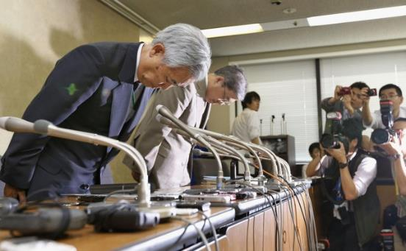
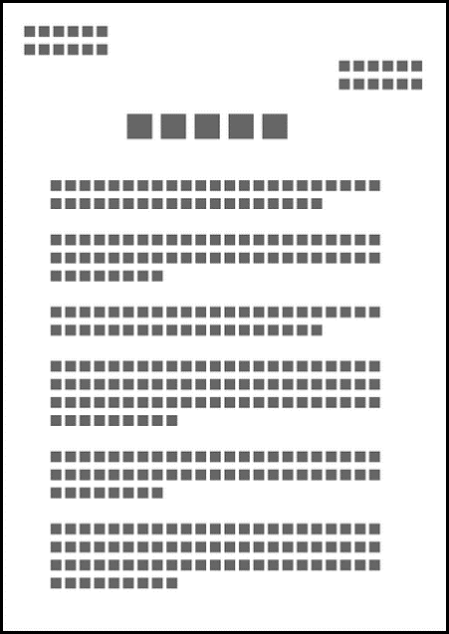
E) Other finding
JPS sent apology letters to the customers whose pension data were affected.
Some of them were sent back as unknown addressees.
⇒ JPS should investigate if such beneficiaries are alive.

Slide 17
4. Conclusion
SAI Japan conducts information security audit as a part of effectiveness audit, where security problems may cause ineffective outcomes in the businesses.
SAI Japan does not have audit division specialized in information security audit.
Nevertheless, they found deficiencies in JPS’s information security.

